Slide 1

Environment and Climate Change Canada Funding Programs
Ivy Whitehorne
Kate Shapiro
Megan Harrison
Thursday, 22 September 2016

Slide 2
Who are we?
Environment and Climate Change Canada (ECCC)’s mandate:
protect and conserve the environment
specific legislation and policies:
Species at Risk
Migratory birds
Wetlands, etc…
ECCC has a number of different programs that provide funding to projects that support these needs
Notes:
Each program has a different area of focus, but there are a lot of commonalities. I’ll be speaking about these programs in general terms here today. I’ll be available for one-on-one. If you have potential projects in mind, I’d be happy to discuss with you about which program would be the best fit, and the details of the requirements for each. We also have some copies of a booklet that’s got all the details on all these programs, and our contact information is available.

Slide 3
What do these programs do?
ECCC’s programs focus on conservation of wildlife and habitat
Promoting clean air, clean water, and nature in communities
Supporting recovery of Species at Risk (species listed under the Species at Risk Act)
Preventing species of conservation concern from becoming at risk
Restoration or enhancement of habitat (wetlands)
Typical activities:
Restoring habitat
Improving habitat
Reducing or eliminating threats
Notes:
IN general, these programs are about supporting specific projects that work to restore, enhance or improve the environment – such as restoring habitat for a species at risk, or reducing threats to a species of concern.

Slide 4
Criteria
Project-oriented, application-based, competitive
All programs are open to indigenous communities and organizations
AFSAR is aimed specifically to indigenous communities and organizations
Various requirements for matching funds, depending on the program
From zero match to 1:1 matching ratio; most programs require 1:1
Match can be cash or in-kind
One round of applications per year in fall
Typical project size: $10,000 - $100,000/yr
Duration: 1 – 3 years
Most programs have priorities (specific areas or species, etc.)

Slide 5
Funding programs
Five key funding programs
Two focus on conserving species:
Aboriginal Funds for Species at Risk (AFSAR)
recovery of species at risk and preventing species from becoming at risk; targeted to indigenous communities and organizations
Habitat Stewardship Program (HSP)
recovery of species at risk and preventing species from becoming at risk

Slide 6
Funding programs
Five key funding programs
Three have broader focus on habitat and the environment:
National Wetland Conservation Fund (NWCF)
restoring and enhancing degraded wetland habitats
EcoAction Community Funding Program
clean air, clean water, and nature in communities
Environmental Damages Fund (EDF)
Court awards from environmental infractions – to restore or improve damaged habitat and support impacted wildlife populations

Slide 7
Program specifics: Aboriginal Funds for Species at Risk
Focused on recovery of federally-listed species at risk and preventing species of conservation concern from becoming at risk.
Targeted to indigenous communities and organizations.
Activities such as:
Habitat improvement and/or protection
Conservation planning and implementation
Monitoring and data collection
Gathering and documenting Aboriginal Traditional Knowledge

Slide 8
Program specifics: Aboriginal Funds for Species at Risk
Only indigenous communities and organizations, or groups in partnership with them, may apply
Match: 20%
Applications due: fall
Range: $10,000 to $70,000/yr
Duration: 1 to 3 years
Amount: About $500,000 available in BC each year

Slide 9
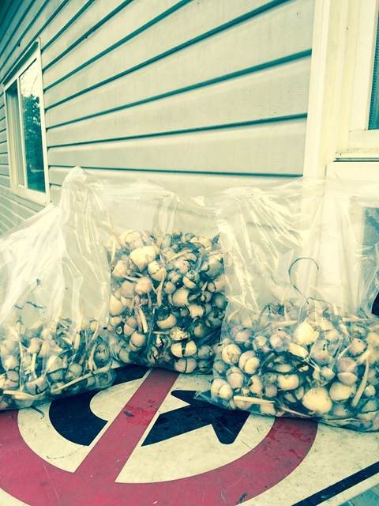
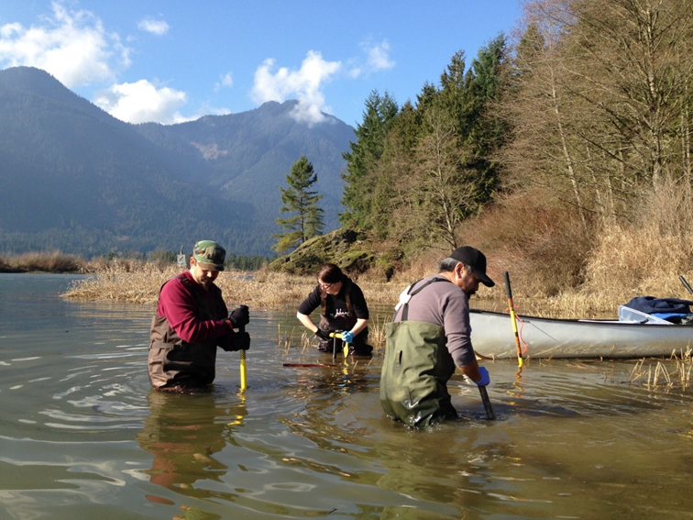
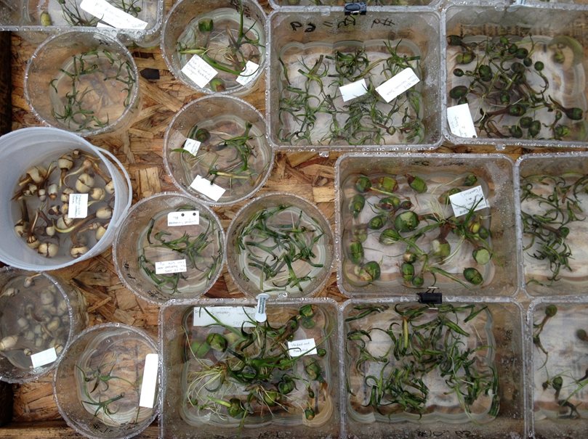
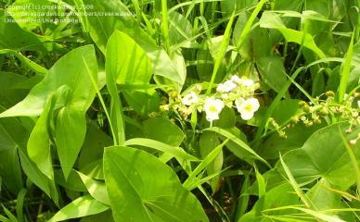
Notes:
Am example from last year – a local First Nation in the lower mainland developed a tank-based system to propagate locally-sourced wapato, to supply future habitat restoration work across their traditional territory, and also for a safe community food supply. Wapato is not SAR, but is of concern and of cultural importance to many First Nations.

Slide 10
Program specifics: Habitat Stewardship Program
Focused on recovery of federally-listed species at risk and preventing species of conservation concern from becoming at risk.
Open to a wider range of applicants than AFSAR; higher matching requirements.
Funding is primarily given to support projects that:
Protect and conserve species at risk and their habitat
Mitigate threats to species at risk caused by human activities

Slide 11
Program specifics: Habitat Stewardship Program
Open to a broad range of applicants: Indigenous organizations, community groups, ENGOs, non-profits, local governments…
Match: 1:1
Applications due: fall
Range: $10,000 to $100,000/yr
Duration: 1 to 3 years
Amount: About $2 to $2.5 million available in BC each year

Slide 12
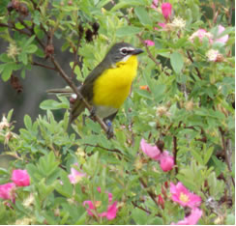
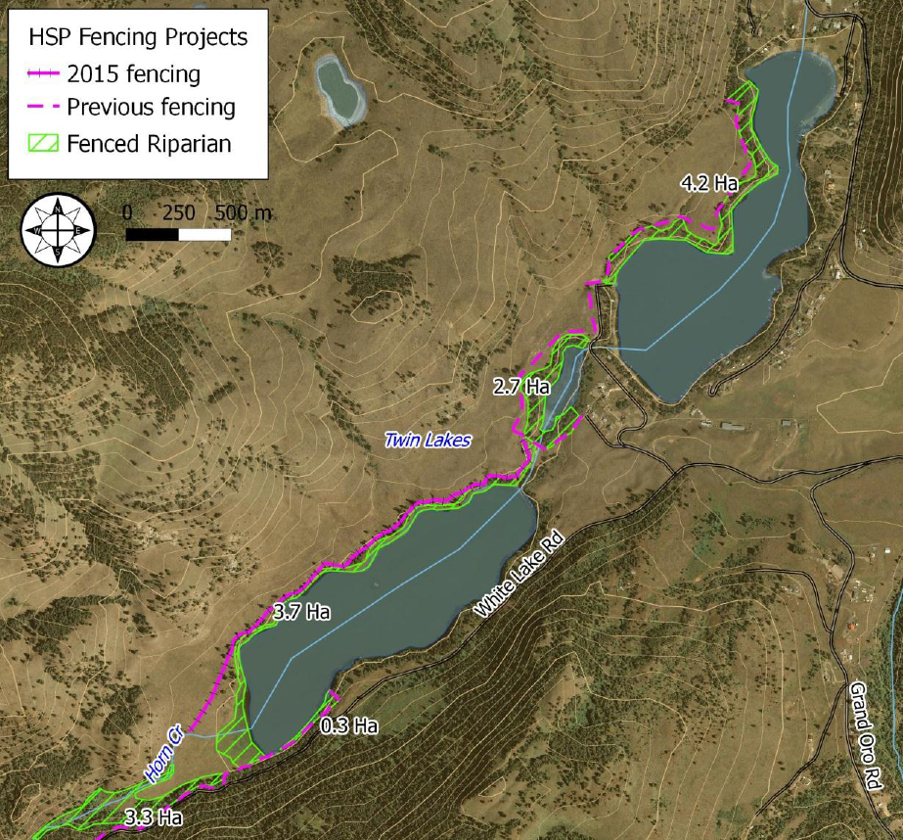
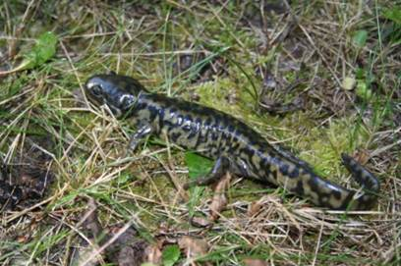
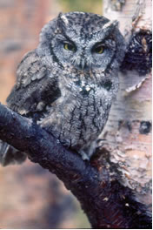
Notes:
Examples: and ENGO restored riparian habitat in the Okanagan by installing fencing to keep livestock out of streamside (riparian) areas. Removes a threat (livestock), protects existing habitat, and allows damaged habitat to recover. Supports several species listed under the Species at Risk Act (western screech-owl, tiger salamander, yellow-breasted chat).

Slide 13
Program specifics: National Wetland Conservation Fund
Focused on restoring lost wetland habitat and enhancing degraded wetland habitats.
Projects can be focused on specific types of wildlife (birds, amphibians, fish, plants, etc.), or services such as water storage, flood/drought mitigation, water quality.
Typical activities are:
re-creation of lost wetlands
restoring hydrology
invasive species removal; planting native species
installing specific habitat features (bird boxes, basking logs, etc).

Slide 14
Program specifics: National Wetland Conservation Fund
Broad range of applicants: Indigenous organizations, community groups, ENGOs, non-profits, local governments, etc.
Match: 1:1
Applications due: fall
Range: $10,000 to $500,000/yr; (most $40 - $80,000/yr)
Duration: 1 to 2 years
Amount: About $1.5million available in BC each year

Slide 15
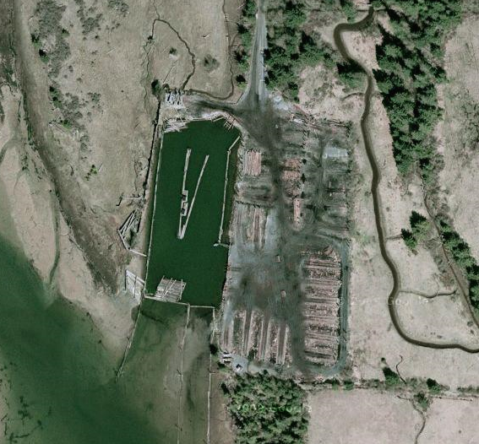
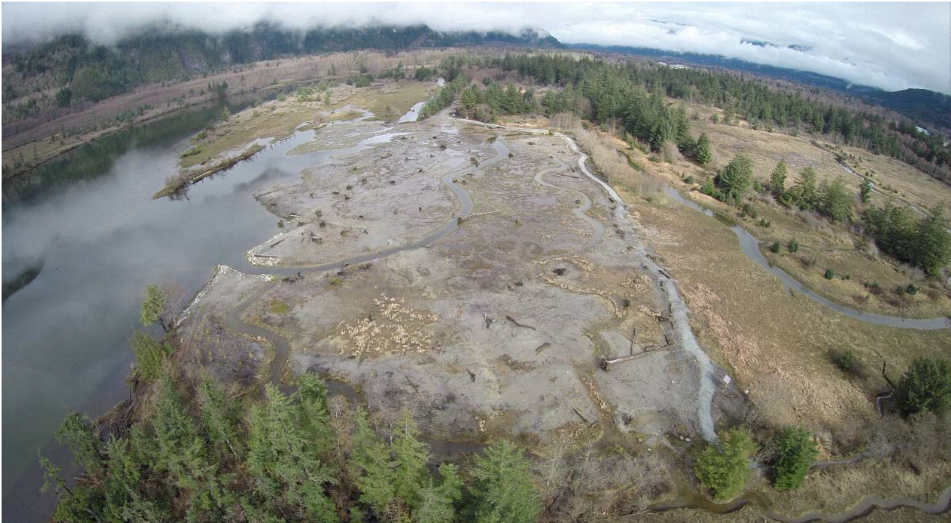
Notes:
Examples: work in the Squamish river estuary. Local ENGO and partners (local schools, province, local FN) removed a no-longer-used industrial log handling and storage side, and restored marsh habitat.

Slide 16
Program specifics: EcoAction
Supports community-based activities for clean air, clean water, and nature.
Open to a broad range of applicants, including indigenous organizations.
Match: 1:1
Applications due: 1 November
Range: most $25,000 to $50,000/yr; maximum $100,000/yr
Duration: 1 to 3 years

Slide 17
Program specifics: Environmental Damages Fund
Provides court-ordered damages from environmental infractions to fund restoration work. Aim is to improve or restore the same type of habitat that was damaged, preferably where the damage occurred or nearby.
Requirements vary depending on the specific award.
Match: None!
Application due: Variable; 3 or 4 rounds per year
Range: Variable, depends on specifics of the court award ($10,000 to $100,000+)
Duration: 1 to 3 years
Notes:
e.g. when a company is fined for violations under the fisheries act, MBCA or other federal environmental legislation, the $$ goes to the EDF. EDF then makes those funds available to support habitat restoration – ideally to repair or offset the original damage that resulted in the fine or settlement. Unlike the other programs isn’t a single pot of funds – each court award it it’s own pot of funds, with a specific purpose. Therefore eligible locations, activities, etc. vary from award to award.

Slide 18
Contacts and Further Information
For information on Environment Canada’s funding programs:
https://www.ec.gc.ca/financement-funding/default.asp?lang=En&n=923047A0-1
To learn more, or if you are interested in applying, please contact:
Kate Shapiro
Aboriginal Liaison Biologist
604-350-1952 (Tues & Weds);
604-664-9044 (Mon & Thurs)
Kate.Shapiro@canada.ca
Ivy Whitehorne
National Wetland Conservation Fund Coordinator
604-350-1939
Ivy.Whitehorne@canada.ca
Megan Harrison
Habitat Stewardship Program Coordinator
604-350-1989
Megan.Harrison@canada.ca

Slide 19
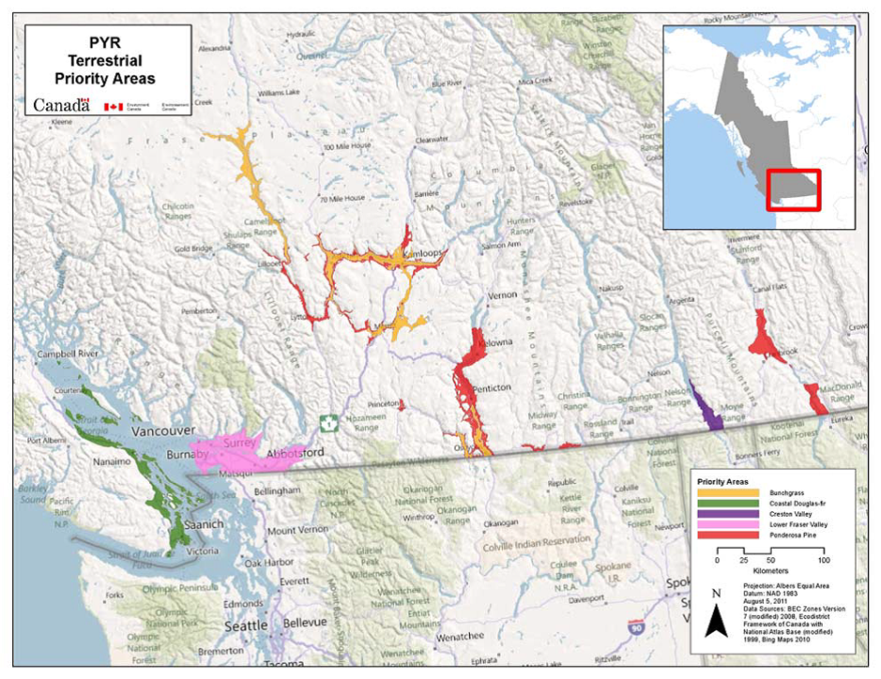

Slide 20
